Slide 1
COMSM0012 Robotic Systems Probabilistic Robotics

Slide 2
Draft Lecture Schedule
Week | Lecture 1 | Lecture 2 | Labs
13 | Introduction | CW1 & Botsim | -
14 | Probabilistic Robotics | Particle Filters (1) | CW1
15 | [no lecture - conference] | Particle Filters (2) | -
16 | Drop in (Particle Filters) | Motion Planning (1) | CW1
17 | Motion Planning (2) | Motion (3) | CW1
18 | Explore Week |  | -
19 | Drop-in (Motion) | CW2 + NXT | (Weds) Marking CW1
20 | Sensors | SLAM | CW2
21 | Special Topic 1 | Drop-in | CW2
22 | Special Topic 2 | Drop-in | CW2 + Extra lab booking
23 | Special Topic 3 | Drop-in | (Weds) Marking CW1
First lab on Thursday – MVB 1.07 & 1.08

Slide 3
Trends in Robotics Research
Classical AI Robotics (mid-70’s)
Sense-Plan-Act
Complex world model and reasoning
Indoor, wheeled, static blocks world
Reactive Paradigm (mid-80’s)
No models: “the world is the model”
Simple sense-act functions
Emergent behavior
Static legged motion,
robot swarms,
reactive
Hybrid Architectures (90’s)
Models at higher levels, reactive at lower levels
Mid-level executive to sequence actions
Complex environments,
mapping and localization,
human-robot interactions
Probabilistic Methods (mid-90’s->)
Uncertain sensing and acting
Integration of models, sensing, acting
Challenging outdoor environments
Air, water vehicles
Dynamic legged motion
[modified slide from K.Konoligue/S. Gutmann]
Notes:
Classical AI – nothing dynamic – world doesn’t change, takes time
Reactive – if this then this, primitive behaviours, animalistic. Still used e.g swarms, Roomba and was huge break through at the time -/ revolutionary thinking by Rodney Brooks
Hybrid combines the two – so you will have an overall plan based on the world model but will react instantaneously to sensor events

Slide 4
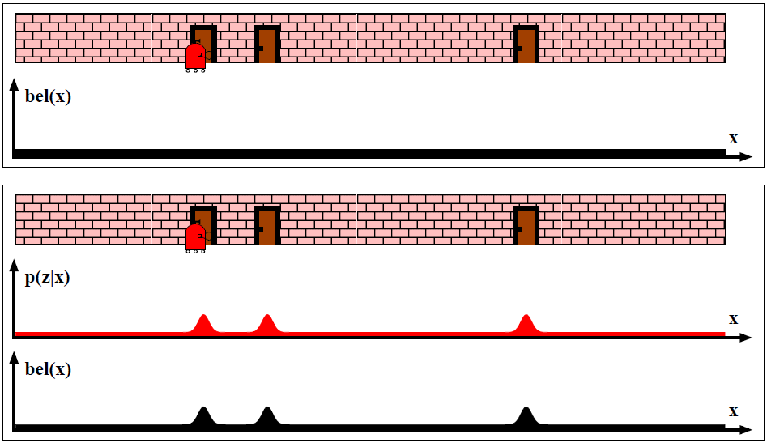
A probabilistic robot...
Uniform distribution
After one measurement, uncertainty is centered around possible locations
Continues…
Slide from [1]
Notes:
Initially, robot could be anywhere
Then it takes a reading z, at which point for each position(x) along the wall we can say what was the probability of getting that reading.
That informs our current belief of where we are.

Slide 5
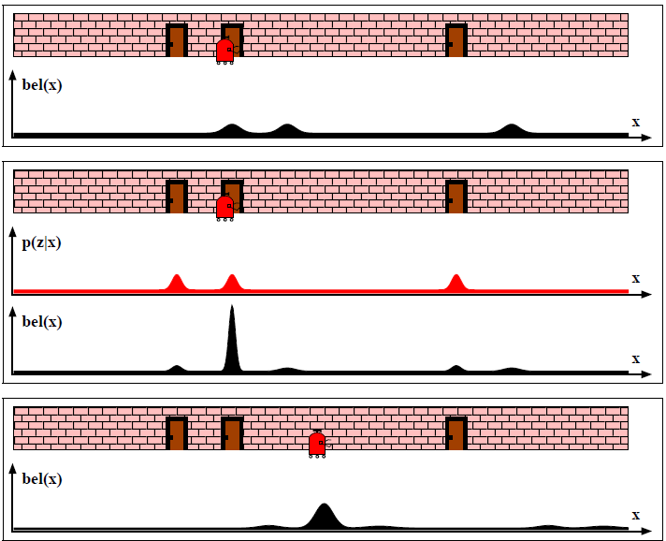
After moving to the right, uncertainty is propagated too (note spread of distributions)
After a further measurement uncertainty reduces
And carries on...
Slide from [1]
Notes:
After moving, our belief is somewhat reduced (wider & lower peaks) due to uncertainty in movement
We can then take another reading and combine our current belief with our evidence in order to get a better estimate and so on and so forth

Slide 6
Probabilistic Robotics
Key idea: Formal representation and management of uncertainty using probability theory.
-> as opposed to a view of a random or perfect world!
Perception = state estimation
Action = utility optimization

Slide 7

Recall that robot measurements and actions are uncertain
BUT we can attempt to model them after repeated
measurements/calibration procedure....
z
d
obstacle
e(d)
e(z)
We can model these as a
probability function e.g.
with a Gaussian distribution
Error from wheel odometry
Error from reported distance

Slide 8
Motion Model
Taking into account error after a translation t:
After a pure rotation by α
Noise variables ε, φ, and β come from a Gaussian distribution with zero mean
and obtained from experimental data.

Slide 9
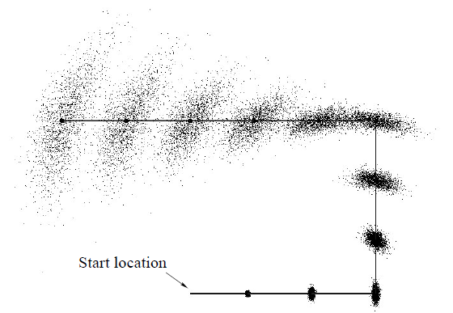
Propagating Uncertainty in Motion
Note only position uncertainty is displayed, orientation may be represented with an arrow
for each particle if needed
Image from [1]

Slide 10
Key concepts
Probability: P(X=x_{i}), or P(x_{i}), is the probability that the random variable X takes on value x_{i}.
Likelihood: P(z|xi) where z is a sensor measurement value.
Prior (probability distribution): models uncertainty before we get new data.
Posterior (probability distribution): expresses uncertainty after measurement.

Slide 11
Bayes Formula
P(x|z) is read as: the probability of x given z. It is also called the posterior probability. We use Bayes Theorem when we want this but actually have P(z|x)
Bayes rule is interesting because allows us to know something about one variable by knowing the value of another. This is because there is some “intersection” or correlation between variables x and z.
Notes:
Don’t give example – about to follow!

Slide 12
Simple Example of State Estimation
Suppose a robot obtains measurement z
What is P(open|z)?
Slide from [1]

Slide 13
Causal vs. Diagnostic Reasoning
P(open|z) is diagnostic
P(z|open) is causal
Often causal knowledge is easier to obtain
How could we get P(z|open) ?
Bayes rule allows us to use causal knowledge:
count frequencies!
Slide from [1]
Notes:
Diagnostic – reading z has no impact on whether the door is open or not. Whether the door is open or not has direct link to value of z; it’s causal.
Think of a medical test – taking the test has no influence on whether the disease is present, but the disease being present has an effect on the likelihood of getting a positive result. It’s diagnostic – we use it to “diagnose” whether the disease is present, or in our case whether the door is open.
How do you think we might find P(z|open)? What does that represent in the real world?

Slide 14
Embellishing Bayes Theorem
Note:
(think Venn diagram)
Conditional probability:
So we can say:

Slide 15
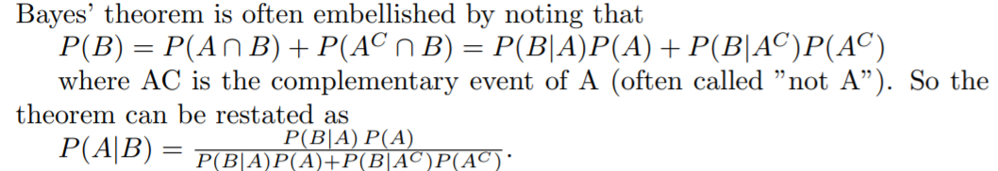
Example
P(z|open) = 0.6 P(z|¬open) = 0.3
P(open) = P(¬open) = 0.5 the ¬ symbol denotes logic “NOT”.
P(open | z) is our measurement update.
Slide from [1]
Bayes info from http://www.eng.utah.edu/~cs5961/Resources/bayes.pdf
Notes:
Probability readings don’t have to add up to 1.0
e.g. 100 readings of door open and get 60 readings of Z then p(z|open) = 0.6
Bottom line of formula comes from an alternative expression of Bayes theorem, essentially represents the overall probability of getting reading z

Slide 16
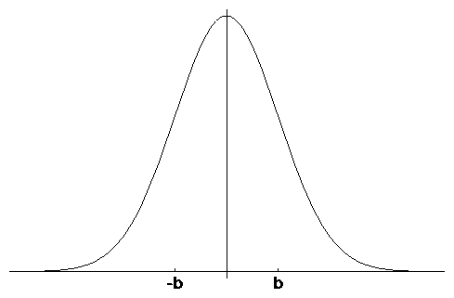
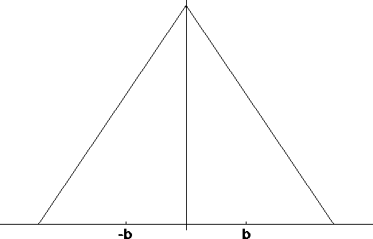
Typical distributions for probabilistic models
Normal distribution
Triangular distribution
0
0
These are one dimensional but in robotics we may use 2D and or 3D versions of these.
If original data mean is not 0, implies a systematic error which can be removed at calibration.

Slide 17
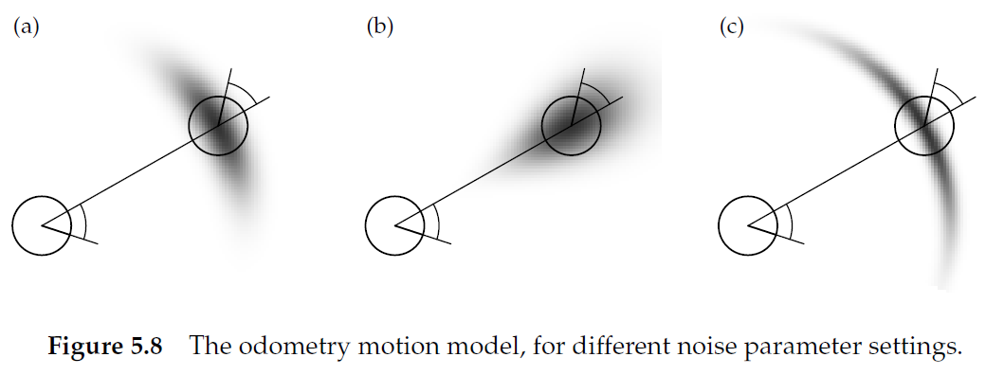
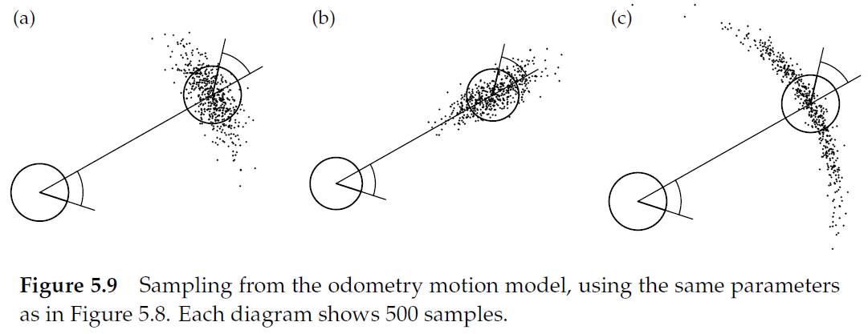
Probability distributions applied to motion models
Uncertainty in:
Orientation+Translation
High in translation
High in orientation
Continuous
Particles
Slide modified from [1]

Slide 18

Using a Gaussian representation
Robot moved right
A door is sensed
New state estimate
Prior
(wide)
Likelihood
Posterior
(tighter)
A normal distribution represents uncertainty well for many cases of sensors.
Can be used to represent prior, likelihood and posterior distributions.
As new measurements are made reduction in uncertainty is represented by a “tighter” (smaller variance) Gaussian.
Common in estimators such as the Kalman filter which is single-hypothesis.

Slide 19
Particle Filter localisation (PFL)
A way to probabilistically estimate where the robot is
Fill our map with “particles” representing possible locations
Compare simulated particle readings with actual robot readings
Rank & reallocate particles iteratively

Slide 20
Using a particles representation
Prior
Posterior
Particle numbers remain the same, reweighting is according to redistribution of belief.
May need relatively large number of particles to represent in detail.
Notice ability to represent multiple hypothesis (more than one peak) more naturally.
Could be difficult to decide which peak is the best estimate!

Slide 21
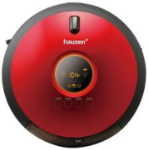
The weighted particle representation
2D Robot’s state vector
Ѳ
y
x
Weights represent the prior/likelihood/posterior of the robot being in such state
The set of particles and their corresponding weights is:
To represent a probability all weights w should add to 1, where N is the number of particles

Slide 22
Summary so far
Probabilistic robotics is a relatively new way to model and deal with the properties of real sensors and actuators.
Probabilistic tools and representations can be used to manage and model uncertainty e.g. Bayes rule, Gaussian distributions, Markov chains, etc.
Provides a formal framework to integrate sensing, action and belief.

Slide 23
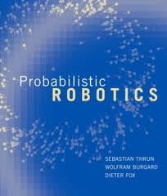
To read further
Chapters 2,7& 8 from
[1] S Thrun, W Burgard and D Fox. Probabilistic Robotics. MIT Press. 2005 http://www.probabilistic-robotics.org/
A. Davison, Modelling the world in real-time: How robots engineer information. Phil Trans Royal Society London. 2003 361, 2875-2890.
http://rsta.royalsocietypublishing.org/content/361/1813/2875.full.pdf

